Slide 1
Change – I need a change
Basic 07 – Unit 7a

Slide 2
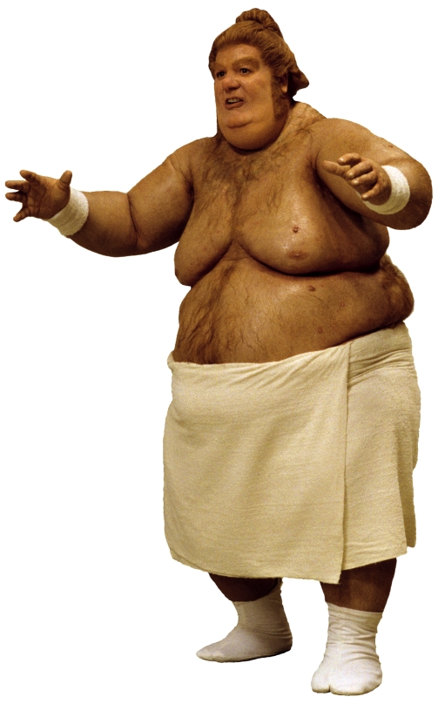
What should he change to feel better?
He eats a lot of junk food, he smokes, he doesn’t exercise and he likes to sleep a lot.
I think he should….

Slide 3
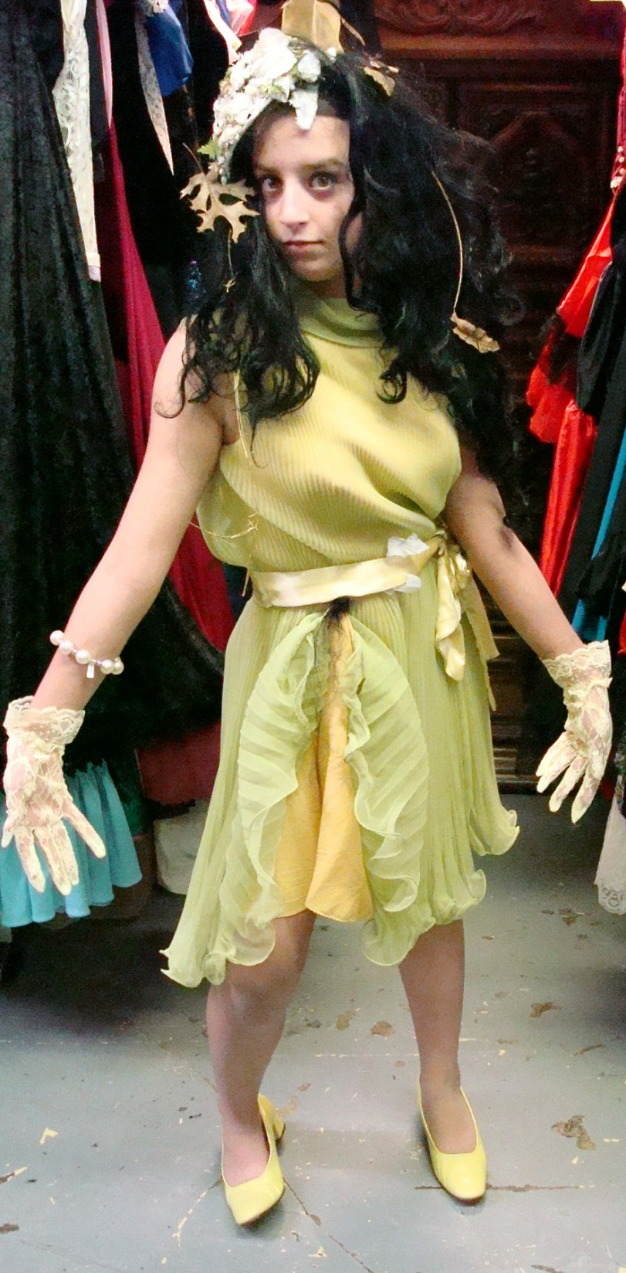
What should she change?
She is very shy, she never brushes her hair, she likes to buy expensive designer clothes, and she has a lot of debts in her credit cards ☹
I think she should….

Slide 4
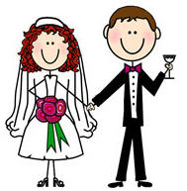
Get married

Slide 5
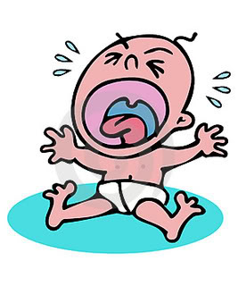
Have a baby

Slide 6
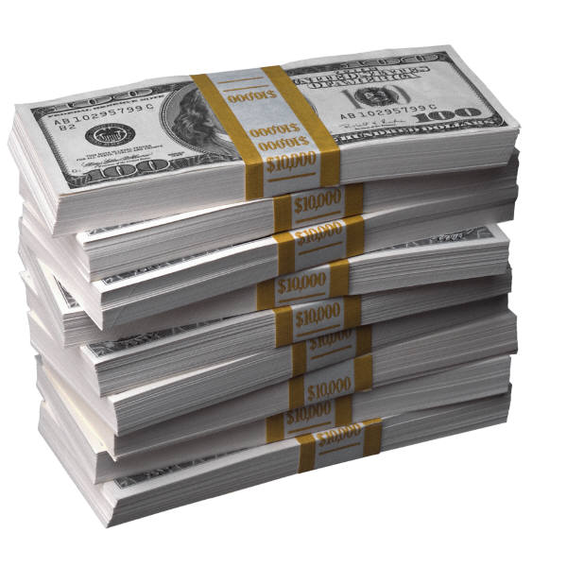
Get a promotion at work

Slide 7
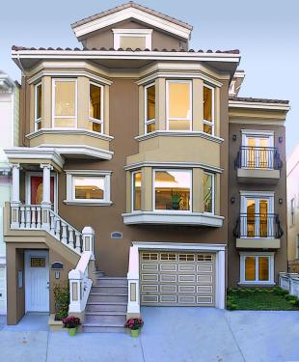
Buy a house / get a new house

